Slide 1

Lucas Co RTA

Slide 2
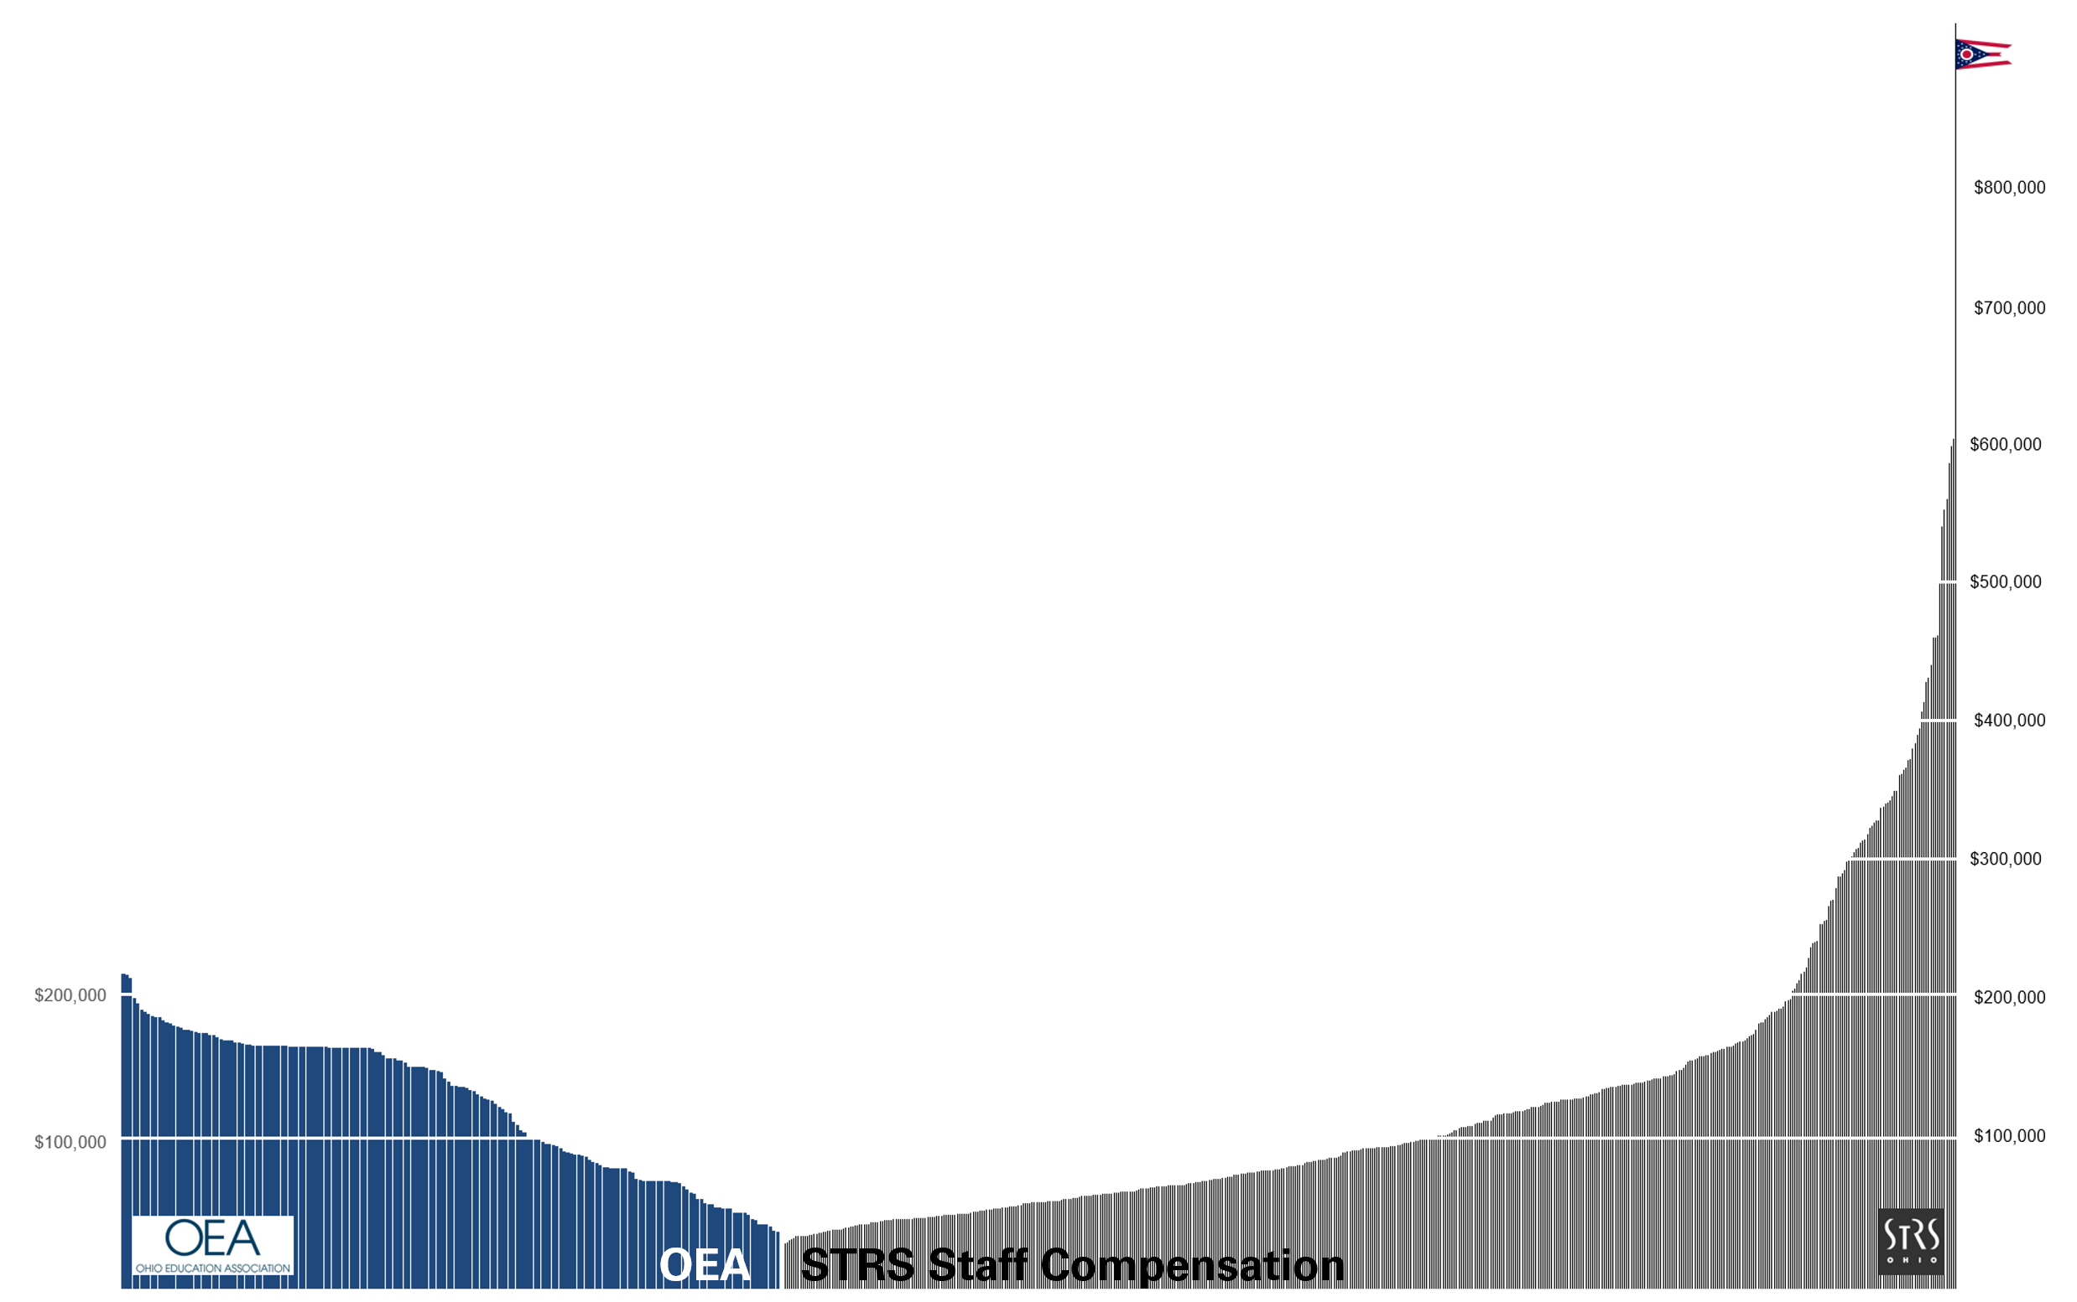
Everybody is getting rich,
except the people who put money in.

Slide 3
Staff Compensation
Source: Ohio Checkbook
$86k
Average bonus in fiscal year 2020
$103m
Total bonus payments since 2006
108
Associates paid more than Governor of Ohio

Slide 4
Staff Have Best Deal in United States
Source: Ohio Checkbook

Slide 5
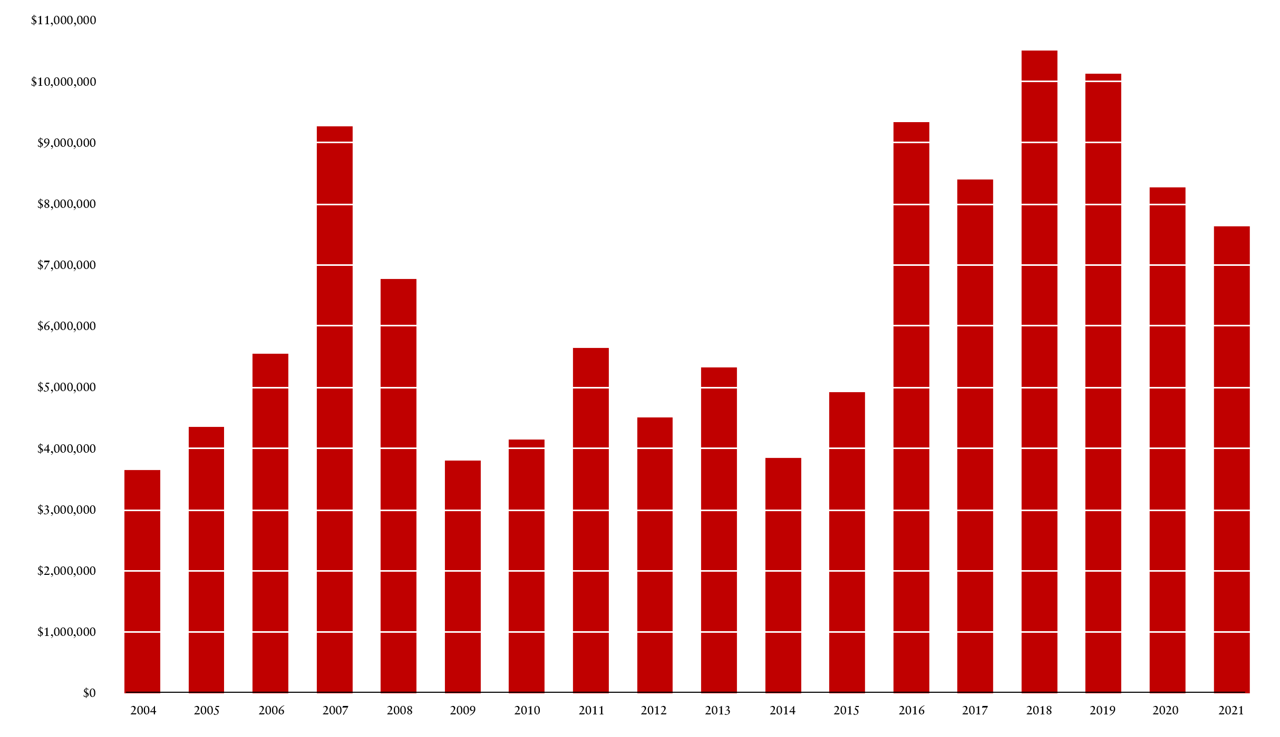
Investment Staff Bonuses
Source: State Teachers Retirement System of Ohio

Slide 6
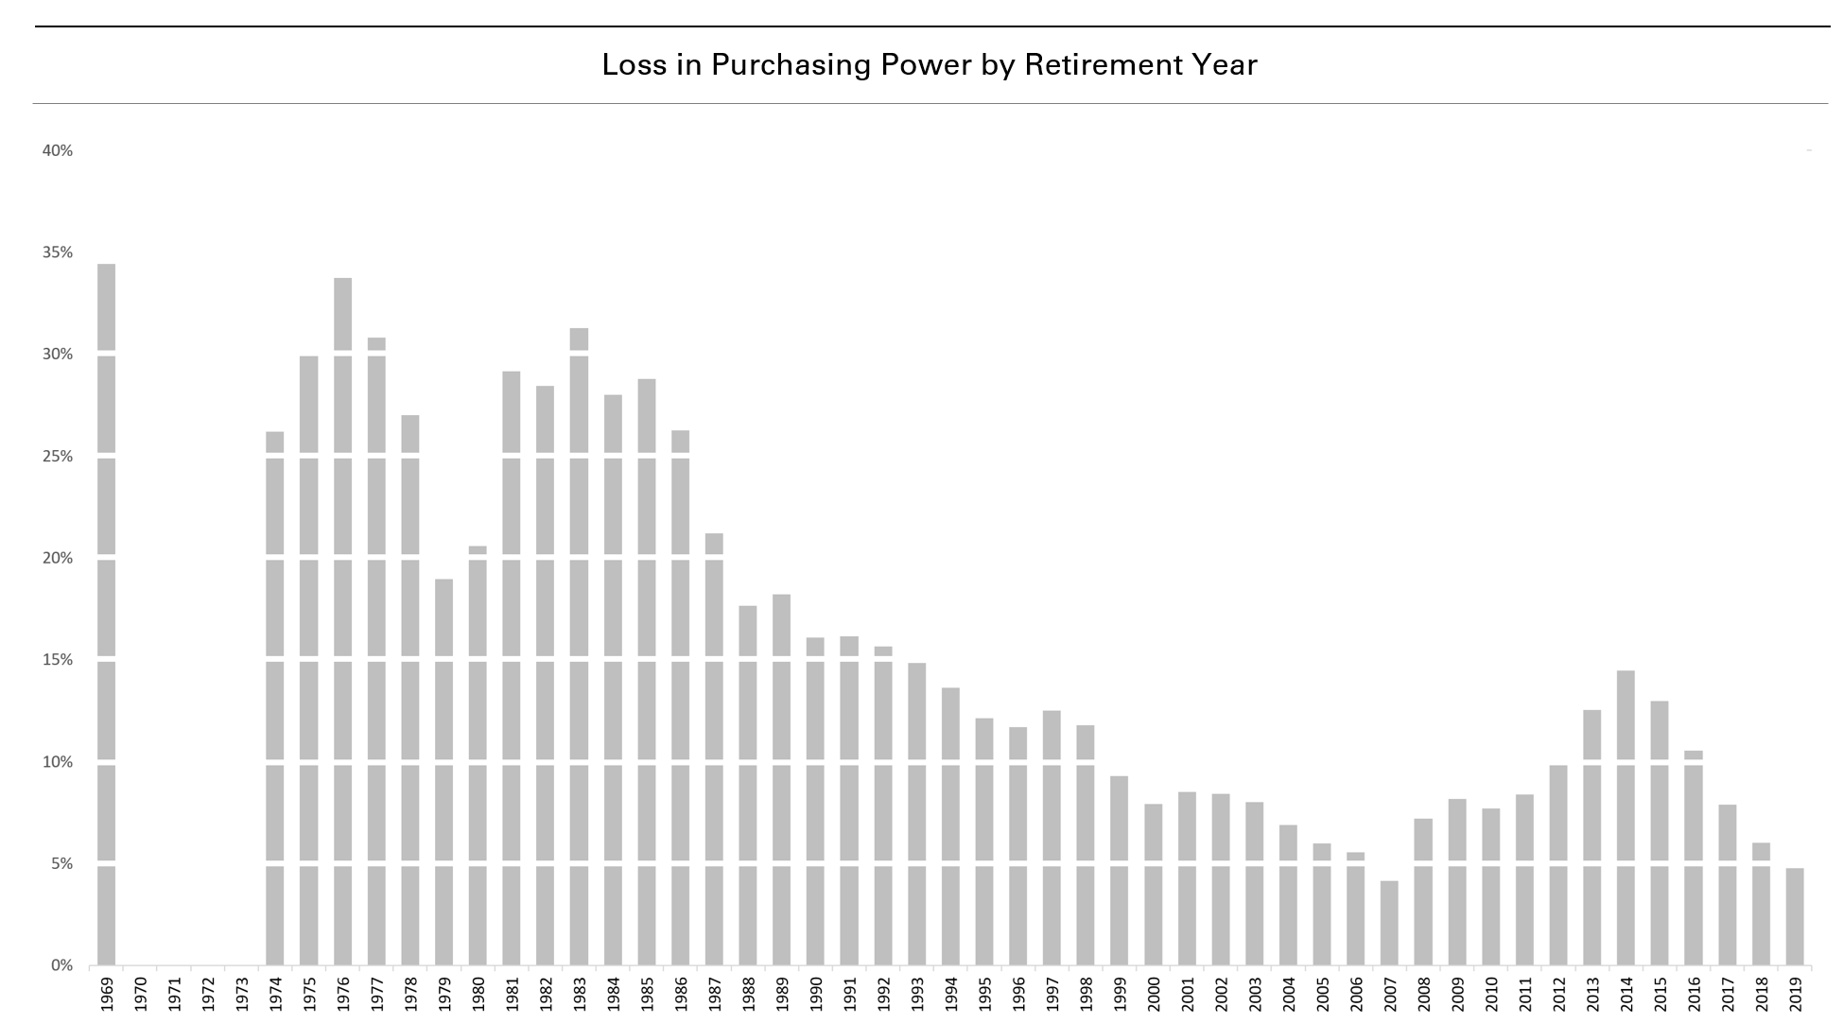
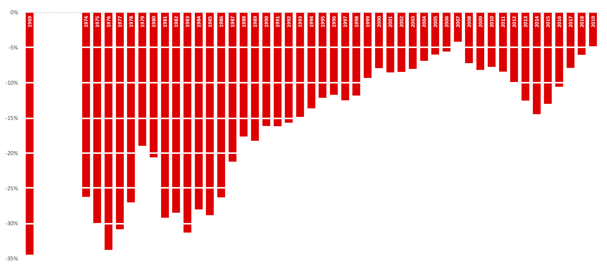
Retirees are Struggling Without COLA
Sources: State Teachers Retirement System of Ohio; U.S. Bureau of Labor Statistics.
No Living Members
No living members

Slide 7
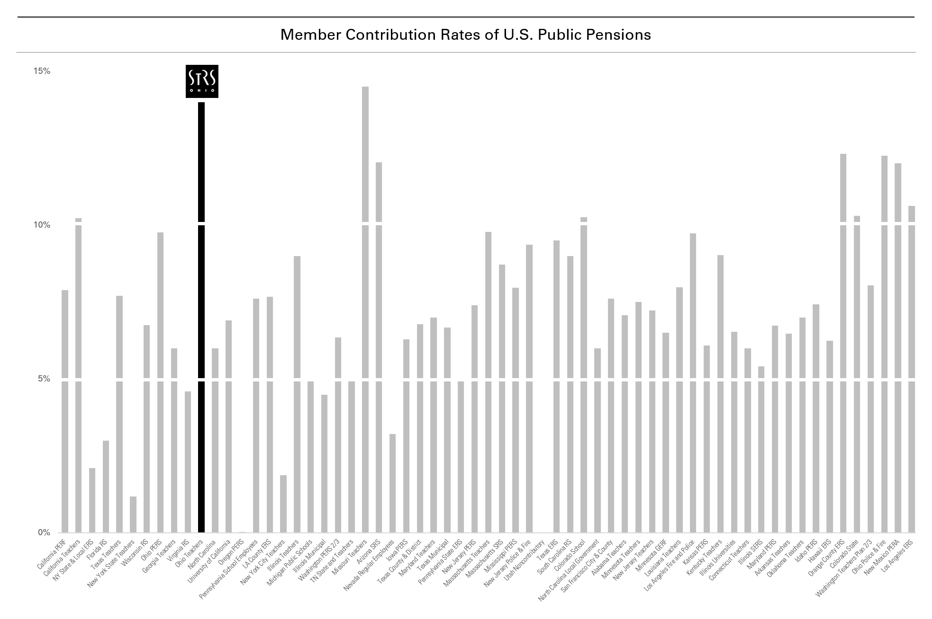
Ohio Teachers are Paying More
Source: Boston College Center for Retirement Research

Slide 8
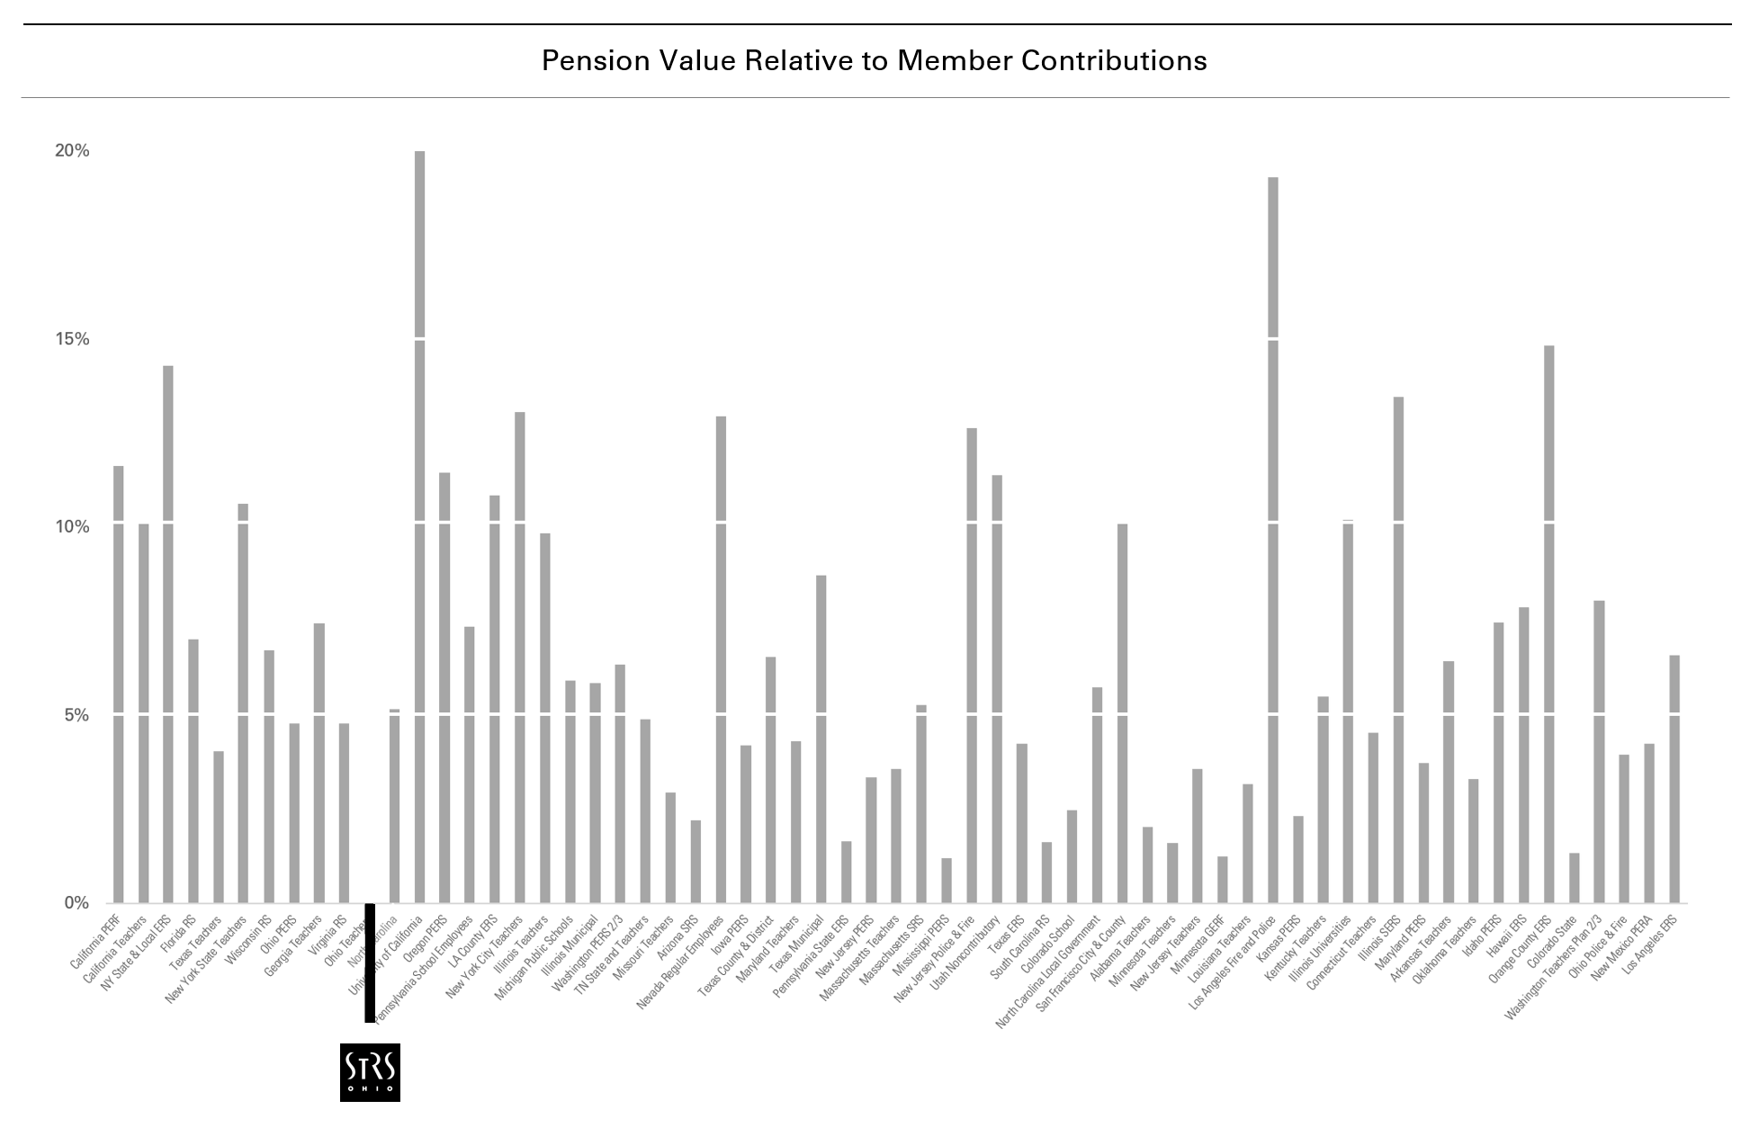
Ohio Teachers Have Worst Deal in United States
Source: Boston College Center for Retirement Research
Active teachers receive $0.77 for every $1.00 they contribute to STRS

Slide 9
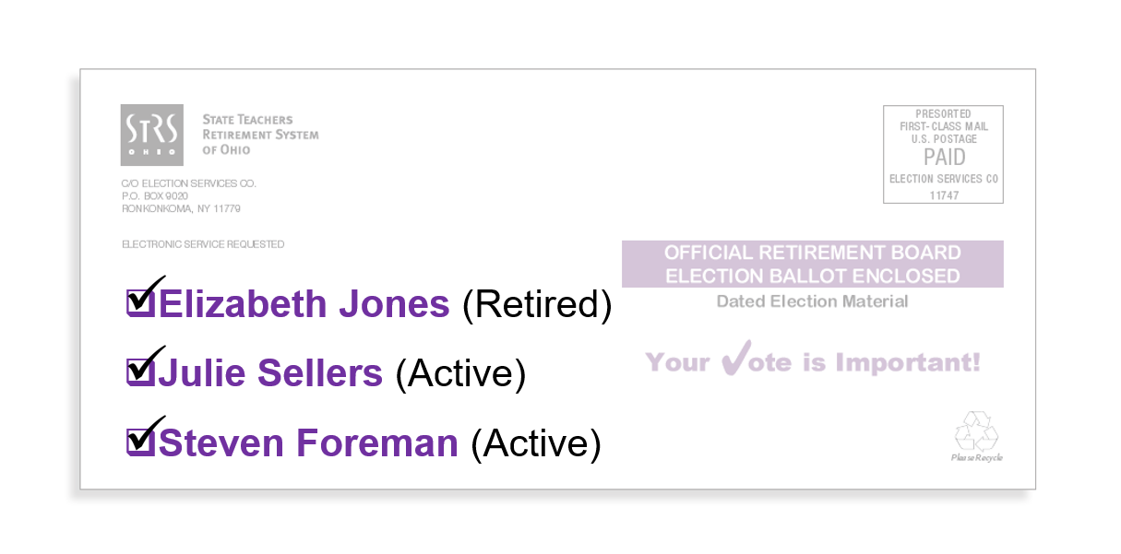
Teachers Deserve Better
Source: STRS Ohio Retirement Board Election Manual 2021

